Slide 1
Multiple-instance Weakly Supervised Object Localization
Thesis – 29/6/2023
Geert Goemaere

Slide 2
Content
Introduction
Research question
Method
Experiments and discussion
Conclusions

Slide 3
Introduction

Slide 4

Multiple-instance WSOL
WSOL
Multiple-instance WSOL
Notes:
The research topic of this thesis is called “multiple-instance weakly supervised object localization” (multiple-instance WSOL).
So, let’s first explain where in the object recognition landscape whe can situate multi-instance WSOL by looking at different tasks in this picture.
Image classification deals with assigning a single label or category) to an image. Here the label is CAT.
Object localization deals with localizing objects in an image by indicating their bounding box. In the case of WSOL, only a single object is localized by training a model with class labels only.
Object detection is the task of locating objects in an image with bounding boxes and assigning a class label for each detection.
Instance segmentation deals with assigning a class label for each pixel of an image.
Just as WSOL, multi-instance WSOL uses only class labels to train a model for localization, but it extends WSOL to find mutiple objects of the same class.

Slide 5
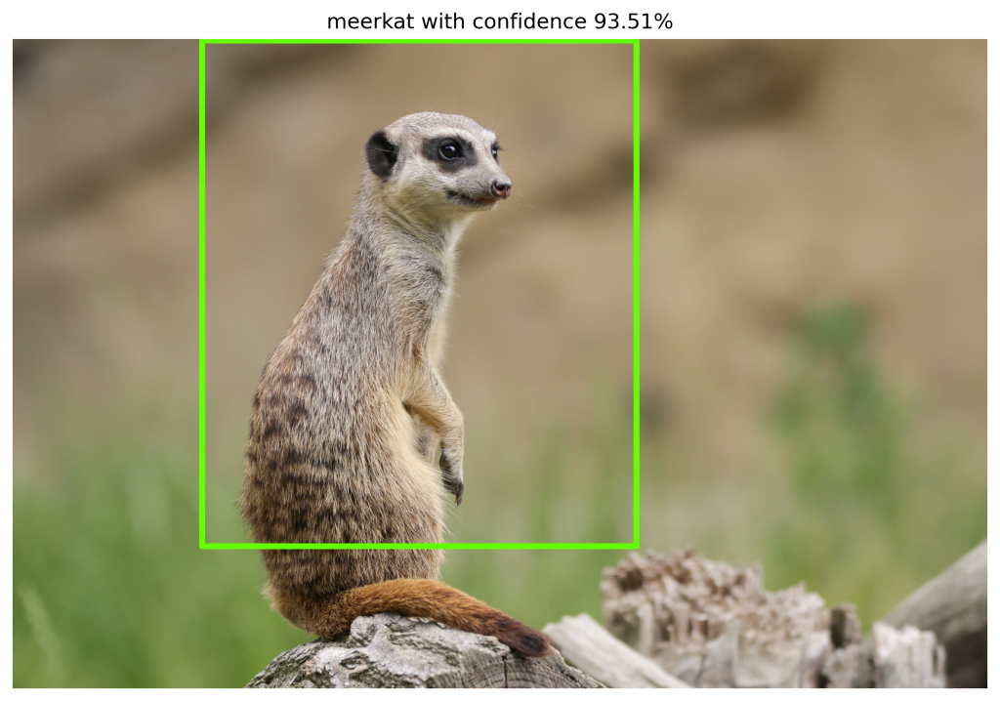
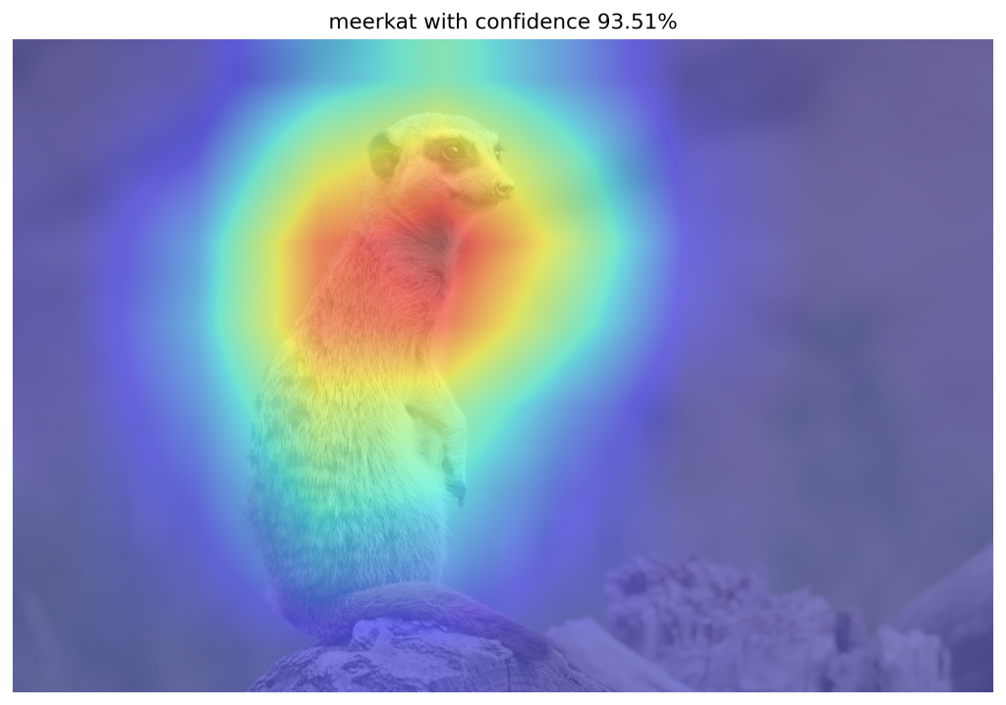
WSOL problem
CAM-based WSOL methods
Class Activation Mapping (CAM)
Localization using discriminative features
Partial object coverage
CAM-based techniques
Grad-CAM, Grad-CAM++, Score-CAM, MinMaxCAM
Problem
Assumption of single image-level class
Multiple-instance localization hasn’t been tested in prior-art

Slide 6
Research question

Slide 7
Research question
Can we use CAM-based methods to evaluate and improve
localization of multiple object instances of the same class
within images for the WSOL task?

Slide 8
Research question - contributions
Can we use CAM-based methods to evaluate and improve
localization of multiple object instances of the same class
within images for the WSOL task?
protocol
Iterative localization
Synthetic dataset

Slide 9
Methodology
Multiple-instance WSOL

Slide 10
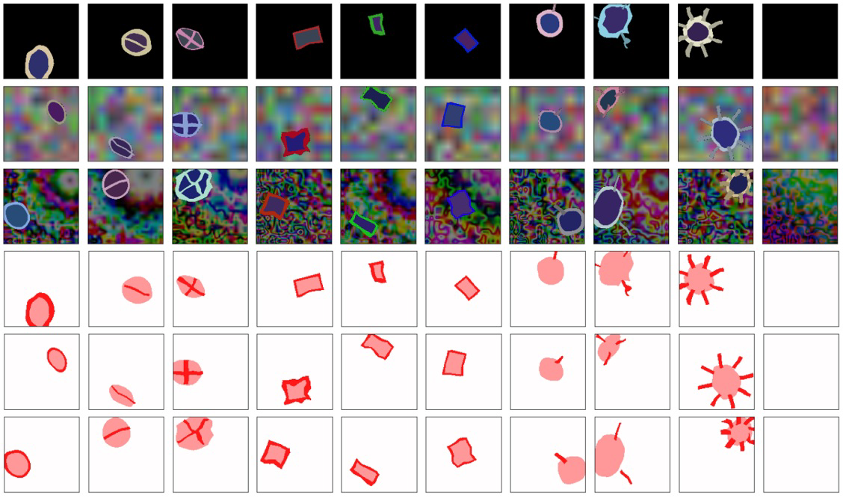
Evaluation protocol - Dataset contribution
Synthetic dataset [Tjoa, E. et al.]
Single instance, 10 classes
GT: image-level class, segment mask
Multiple-instance datasets
Multiple instances, single class
8 datasets: d<1..4><b|t>
d3b: images with 3 object instances on background (b)
d2t: images with 2 object instances on transparent (t) background
GT: image-level class, segment mask (object), bounding boxes

Slide 11
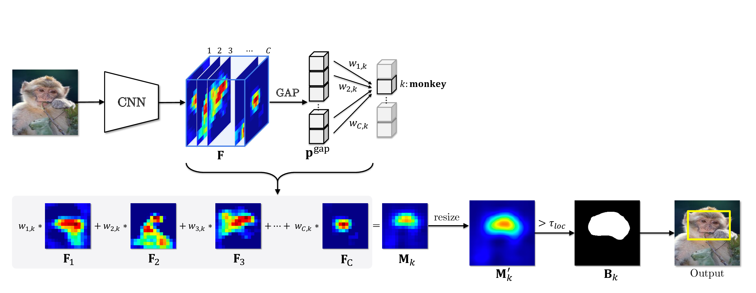
Evaluation protocol – Multiple-instance localization
Classifier is trained using image-level class labels
Activation map = weighted (*) combination of feature maps
Binary mask = Activation map > threshold 𝛕
Predicted bounding boxes are computed from contours in binary mask
(*) Weight computation is specific to CAM-based method

Slide 12
Evaluation protocol – Multiple-instance metrics
Best matches
BM = ∀i max_{IoU} ∀j IoU(GT_{i} , PR_{j})
True matches
∀i IoU(BM_{i}) > 𝜹
E.g.: 𝜹 = 0.5
PR₂
GT₁
PR₁
PR₃
GT₂
CM | Nr | Elements
TP | 1 | (GT₁,PR₁)
FP | 2 | (PR₂), (PR₃)
FN | 1 | (GT₂)

Slide 13
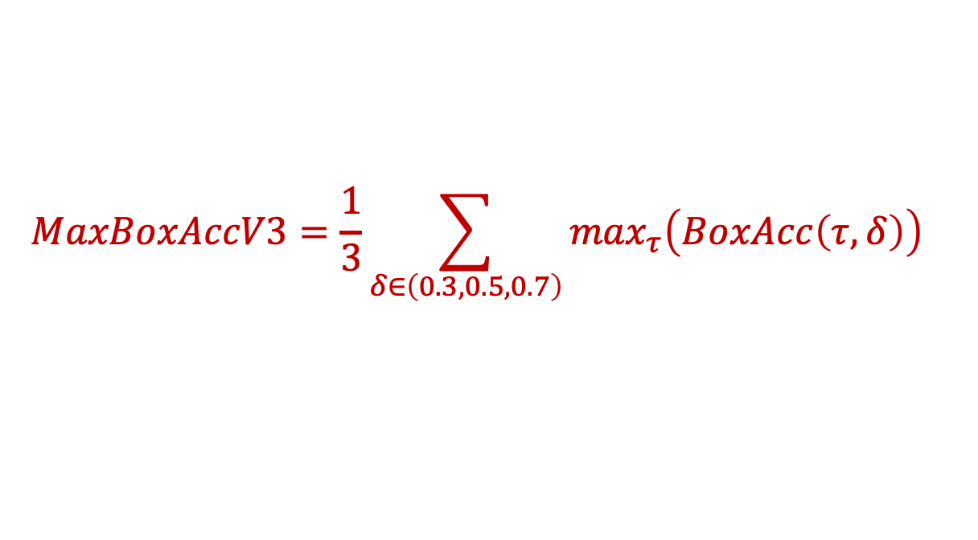
Metrics – MaxBoxAccV3
MaxBoxAccV3: enhances MaxBoxAccV2 [Choe et al., 2020b]
For each GT bounding box: Find best match with predicted bounding boxes
$$MaxBoxAccV3=\frac{1}{3}\sum_{δ∈\left(0.3,0.5,0.7\right)}{\max_{τ}\left(BoxAcc\left(τ,δ\right)\right)}$$

Slide 14
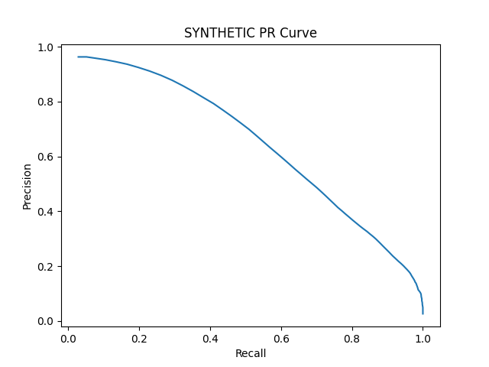
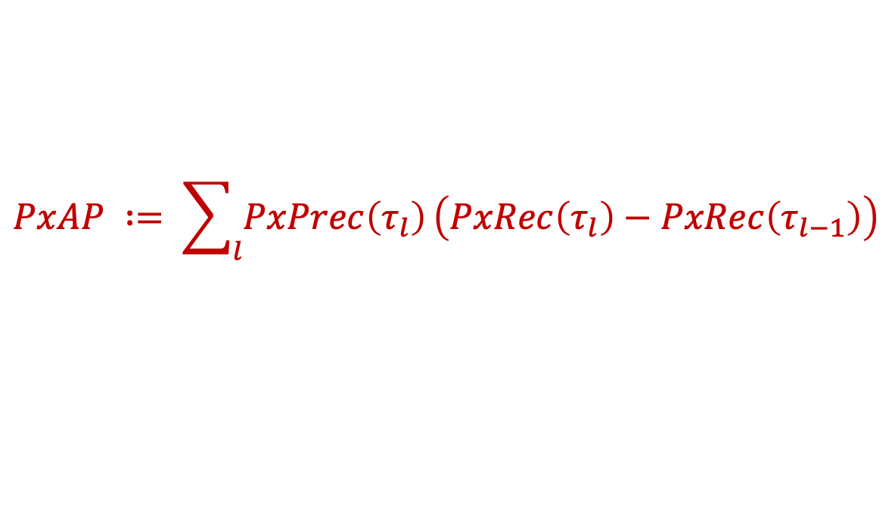
Metrics – Pixel Average Precision (PxAP)
PxAP already used in [Choe et al., 2020b]
Applies to multi-instance localization
Only usable when GT segmentation masks available
$$PxAP ∶= \sum_{l}{PxPrec\left(τ_{l}\right)}\left(PxRec\left(τ_{l}\right)−PxRec\left(τ_{l−1}\right)\right)$$

Slide 15
Experiments

Slide 16
Localization performance – MaxBoxAccV3
 | VGG16-GAP (SYNTHETIC object instances) |  |  |  | VGG16 (SYNTHETIC object instances)
Method | 1 | 2 | 3 | 4 | 1 | 2 | 3 | 4
CAM | 86.83 | 45.58 | 41.50 | 15.71 | - | - | - | -
GradCAM | 86.83 | 45.58 | 41.50 | 15.71 | 74.50 | 32.08 | 30.17 | 9.17
ScoreCAM | 91.83 | 60.08 | 56.28 | 26.50 | 70.50 | 43.08 | 35.17 | 13.25
MinMaxCAM | 87.17 | 48.92 | 45.99 | 16.00 | - | - | - | -
Notes:
VGG16:
All methods
Good at single-instance
Drops significantly for 2/3 instances
Bad for 4 instances
ScoreCAM
has best MaxBoxAccV3 performance (bar VGG16 single instance)
big difference with others: 5-15 percentage points
Concurs with paper conclusions that ScoreCAM is better in localizing multiple instances
VGG16-GAP versus VGG16
VGG16-GAP significantly better performance
VGG16 has no GAP layer annd 3 FC-layers which adds complexity (more learnable weights) and a less direct relationship between feature maps and classification score.

Slide 17
Localization performance – PxAP
 | VGG16-GAP (SYNTHETIC object instances) |  |  |  | VGG16 (SYNTHETIC object instances)
Method | 1 | 2 | 3 | 4 | 1 | 2 | 3 | 4
CAM | 86.87 | 63.46 | 58.40 | 29.04 | - | - | - | -
GradCAM | 86.87 | 63.46 | 58.40 | 29.04 | 67.99 | 39.15 | 41.93 | 13.05
ScoreCAM | 85.64 | 70.06 | 67.66 | 38.97 | 68.80 | 53.33 | 45.85 | 21.40
MinMaxCAM | 86.55 | 65.35 | 61.21 | 26.51 | - | - | - | -
Notes:
Similar picrture as for MaxBoxAccV3.
- ScoreCAM performs best by large margin for multiple instances.

Slide 18
Learning curves
Observations
Example: MinMaxCAM for VGG16-GAP SYNTHETIC
Best localization after few training epochs
Further classification training hurts localization
Focus on most discriminative parts
In line with Choe et al, 2020b findings

Slide 19
Next steps

Slide 20
Next steps
Benchmarking for ImageNet-1k dataset and for ResNet50
Try possible improvement leads for multi-instance localization
Iterative bounding box extraction
Feed image to model and compute feature activation maps (CAMS)
Extract bounding boxes from binarized CAMS
Mask bounding box areas in image (e.g. with noise, zero values)
Repeat until some stop criterion
Variant: Mask image with binarized CAMs

Slide 21



Slide 22
Backup

Slide 23
Method

Slide 24
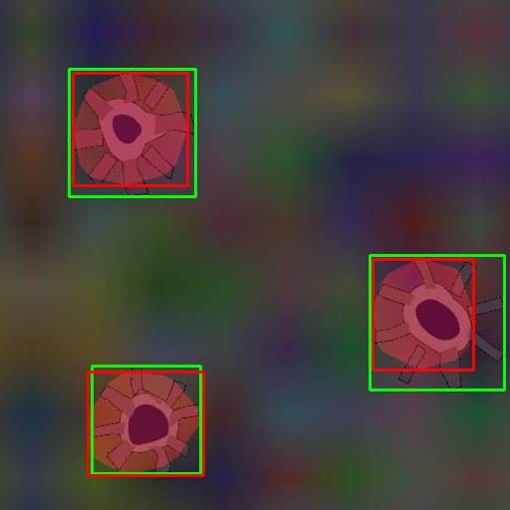
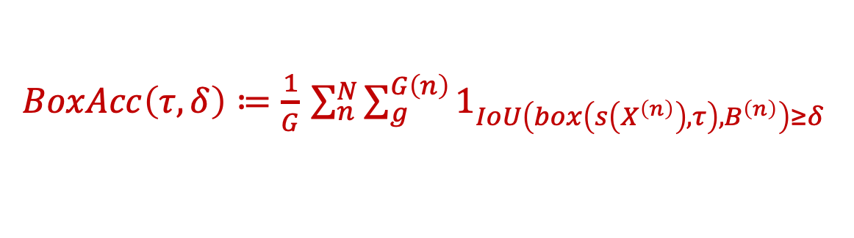
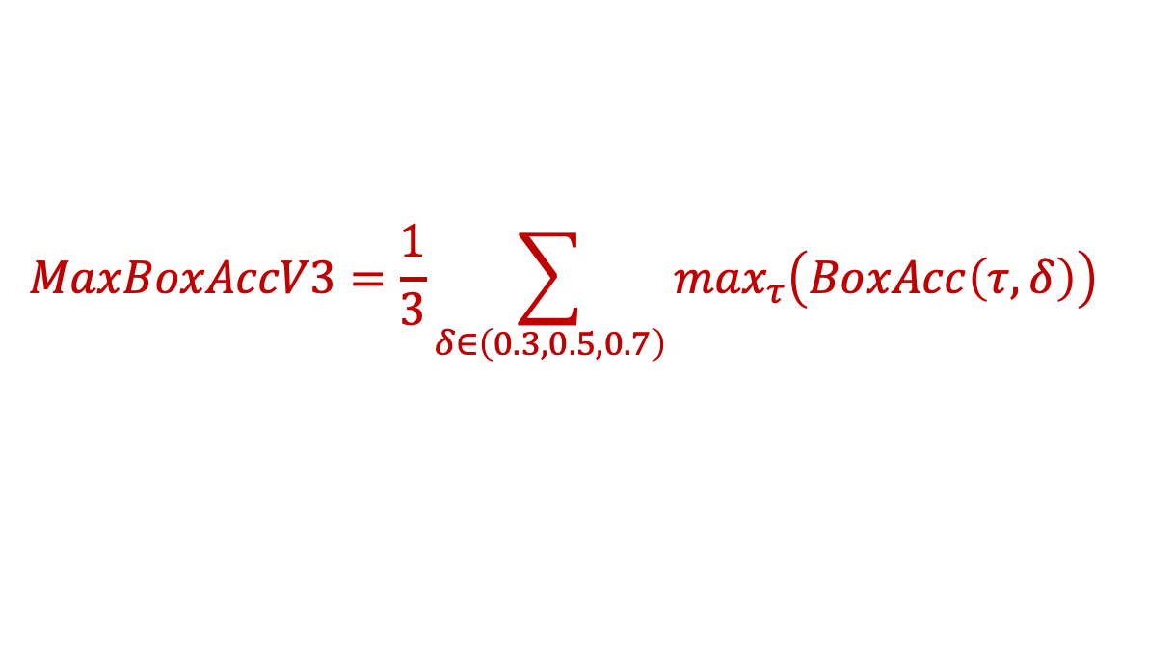
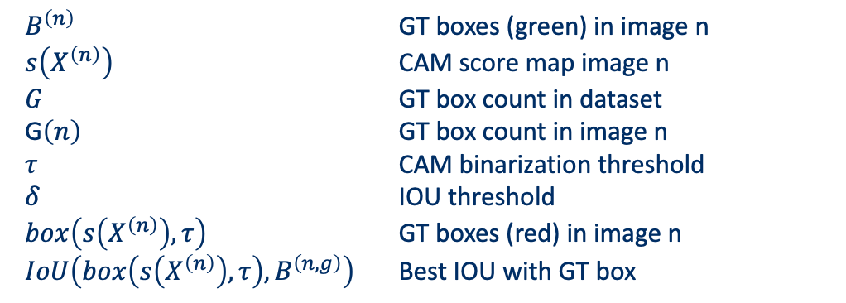
Metrics – MaxBoxAccV3
$$MaxBoxAccV3=\frac{1}{3}\sum_{δ∈\left(0.3,0.5,0.7\right)}{\max_{τ}\left(BoxAcc\left(τ,δ\right)\right)}$$
Choe et al, 2020b: MaxBoxAccV2 modified for multi-instance WSOL
$BoxAcc\left(τ,δ\right)≔\frac{1}{G}$ $\sum_{n}^{N}{\sum_{g}^{G\left(n\right)}{1_{IoU\left(box\left(s\left(X^{\left(n\right)}\right),τ\right),B^{\left(n\right)}\right)≥δ}}}$
$B^{\left(n\right)}$ GT boxes (green) in image n
$s\left(X^{\left(n\right)}\right)$ CAM score map image n
$G$ GT box count in dataset
G$\left(n\right)$ GT box count in image n
$τ$ CAM binarization threshold
$δ$ IOU threshold
$box\left(s\left(X^{\left(n\right)}\right),τ\right)$ GT boxes (red) in image n
$IoU\left(box\left(s\left(X^{\left(n\right)}\right),τ\right),B^{\left(n,g\right)}\right)$ Best IOU with GT box

Slide 25

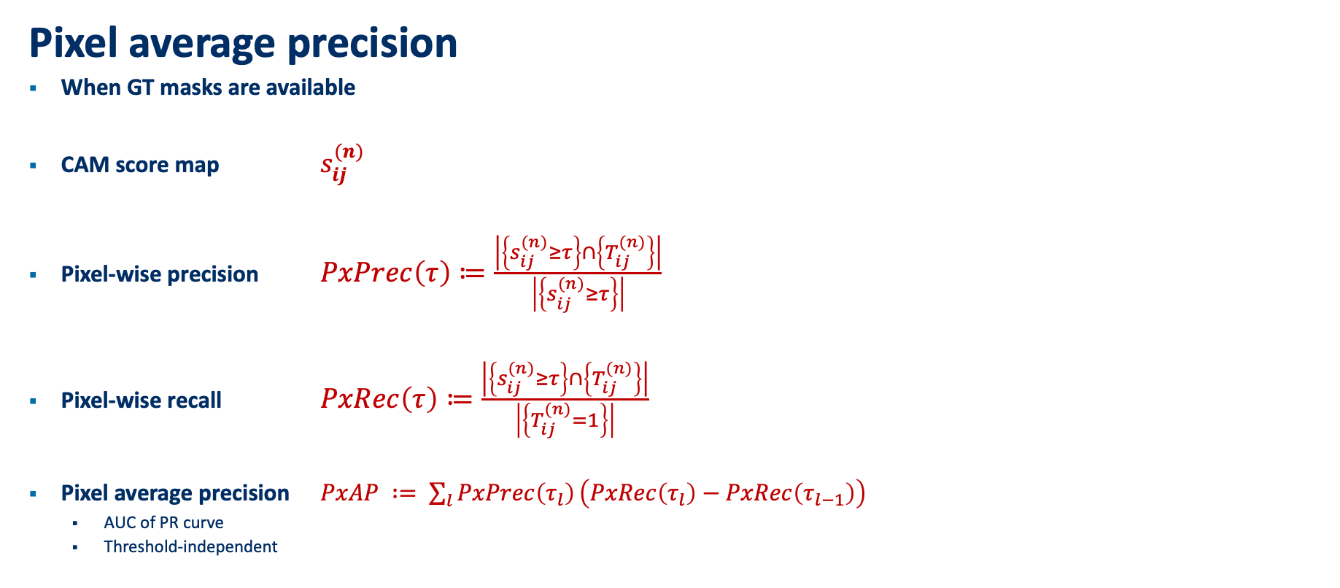
Multiple-instance WSOL - Metrics
Pixel average precision
When GT masks are available
CAM score map $s_{ij}^{(n)}$
Pixel-wise precision $PxPrec\left(τ\right)≔\frac{\left|\left\{s_{ij}^{(n)}≥τ\right\}\right.∩\left.\left\{T_{ij}^{(n)}\right\}\right|}{\left|\left\{s_{ij}^{(n)}≥τ\right\}\right|}$
Pixel-wise recall $PxRec\left(τ\right)≔\frac{\left|\left\{s_{ij}^{(n)}≥τ\right\}\right.∩\left.\left\{T_{ij}^{(n)}\right\}\right|}{\left|\left\{T_{ij}^{(n)}=1\right\}\right|}$
Pixel average precision $PxAP ∶= \sum_{l}{PxPrec\left(τ_{l}\right)}\left(PxRec\left(τ_{l}\right)−PxRec\left(τ_{l−1}\right)\right)$
AUC of PR curve
Threshold-independent

Slide 26
Experiments

Slide 27
Box Accuracy at varying CAM thresholds (IOU 50)
Notes:
BoxAcc for 1, 2, 3, 4 instance datasets
1 instance: All CAM methods perform similarly, outperformed by ScoreCAM
2,3,4: ScoreCAM performance margin over others even more pronounced
Optimal CAM threshold similar for all methods

Slide 28
Precision-Recall at varying CAM thresholds
Notes:
PR-Curves at varying CAM thresholds:
Allows us to choose preferred operating thresholds that provides the best precision-recall trade-off
1 instance: similar performance for all methods
2,3,4 instance:
ScoreCAM outperforms rest
AUC drops significantly

Slide 29
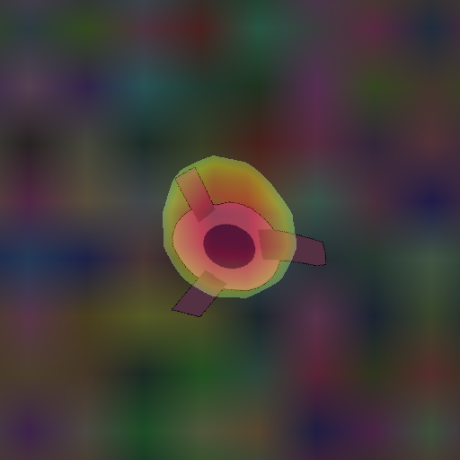
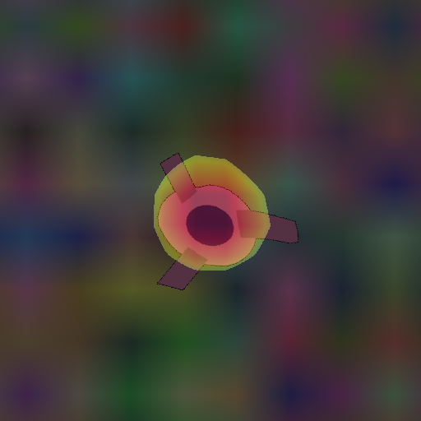
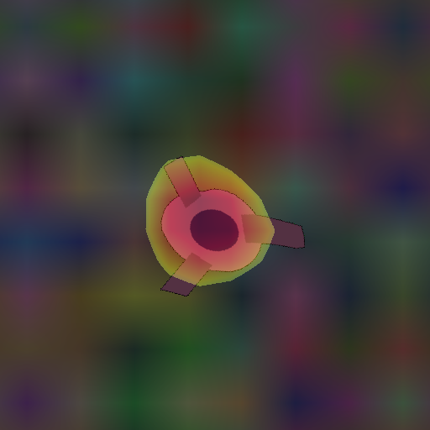
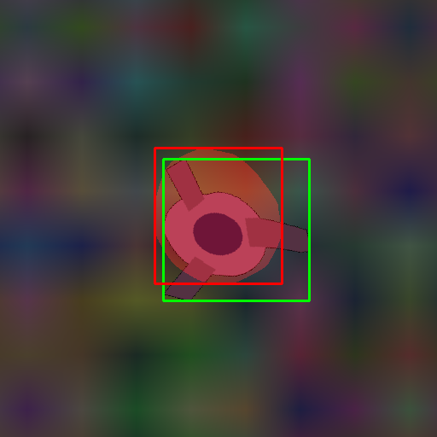
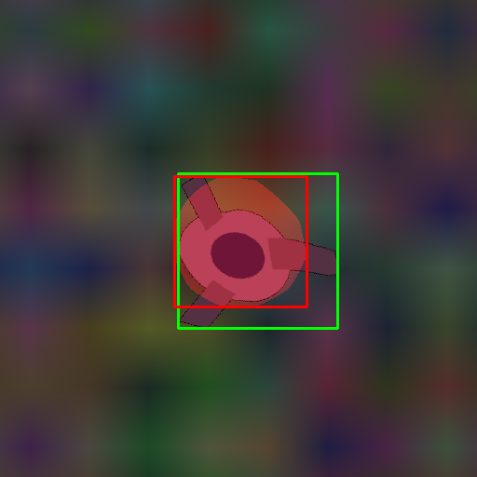
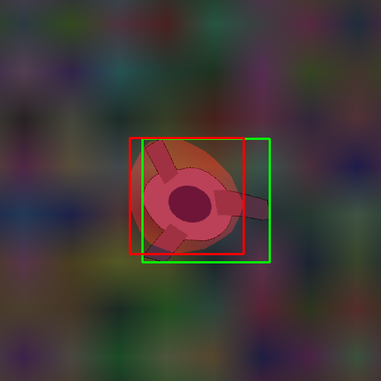
Qualitative analysis: SYNTHETIC – 1 instance
CAM (test119)
MinMaxCAM
ScoreCAM
Notes:
Single instance performance seems similar for all CAM methods
MinMaxCAM: slightly worse. May not be regularized enough.

Slide 30
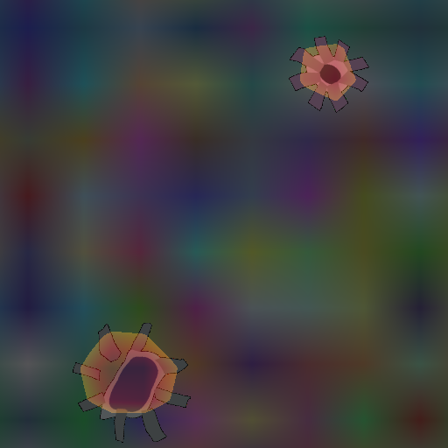
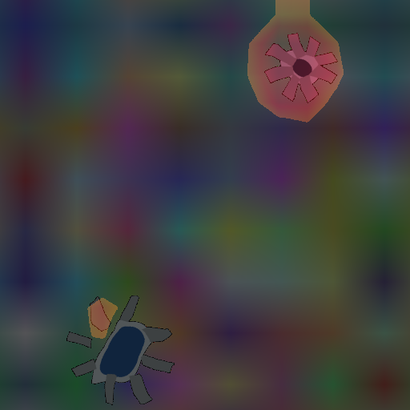
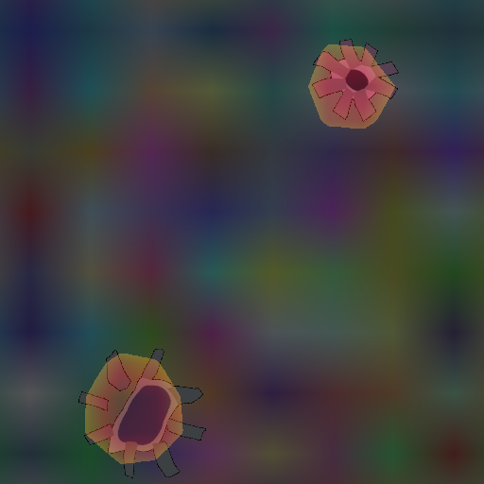
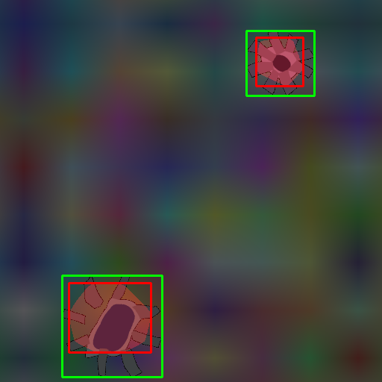
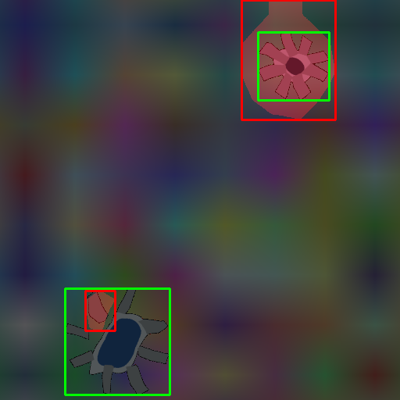
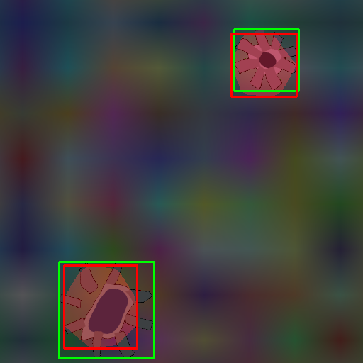
Qualitative analysis: SYNTHETIC – 2 instances
CAM (test102)
MinMaxCAM
ScoreCAM
Notes:
CAM focus on most discriminative features and underfits instances
MinMaxCAM: Overfitting 1 instance, partly fitting other instance
ScoreCAM more accurately loalizes multiple instances
A score-weighted combination of feature maps instead of a global average weighted one, seems better to solve the problem of identifying mutiple occurrences of the same class in an image..

Slide 31
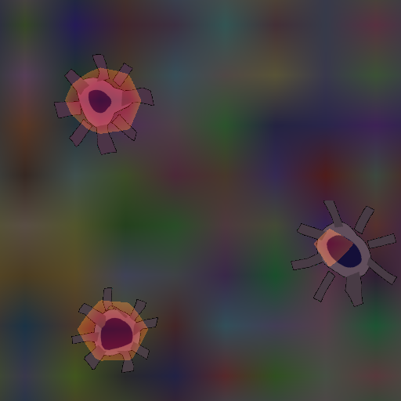
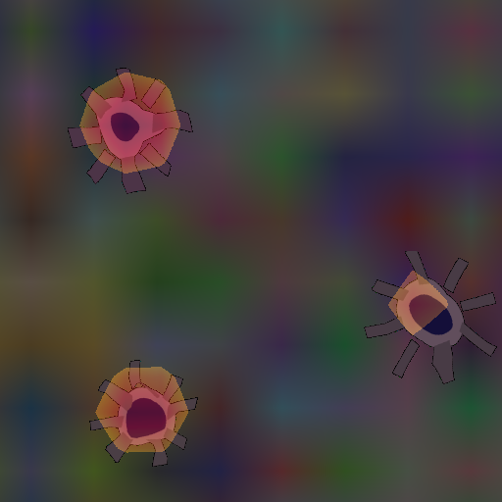
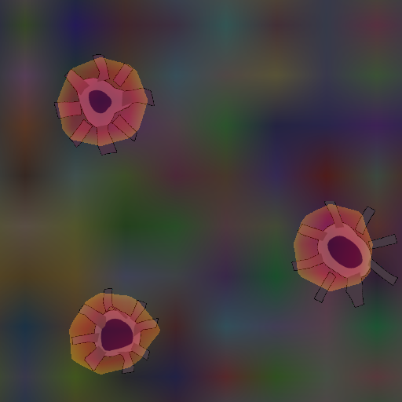
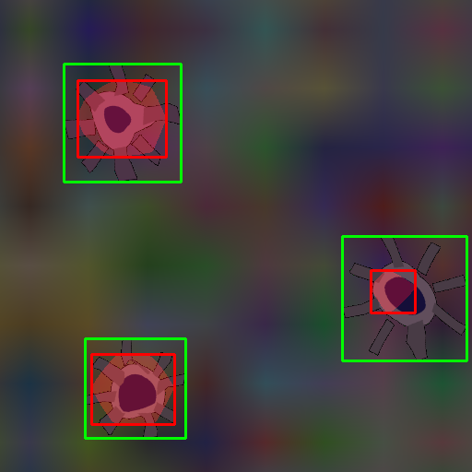
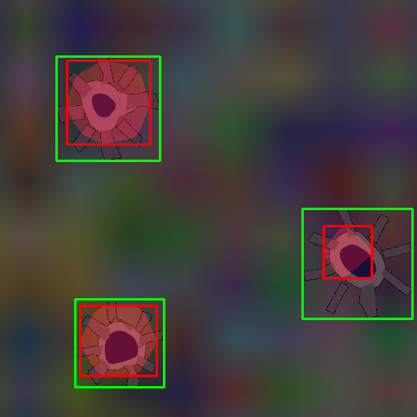
Qualitative analysis: SYNTHETIC – 3 instances
CAM (test103)
MinMaxCAM
ScoreCAM
Notes:
Same conclusions as for 2 instances.

Slide 32
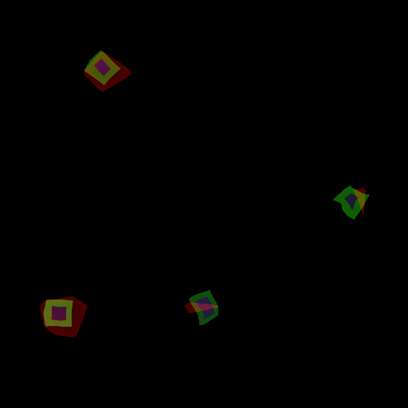
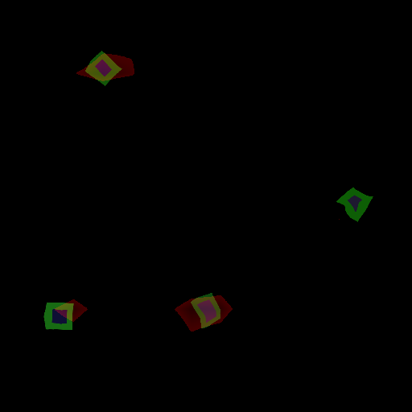
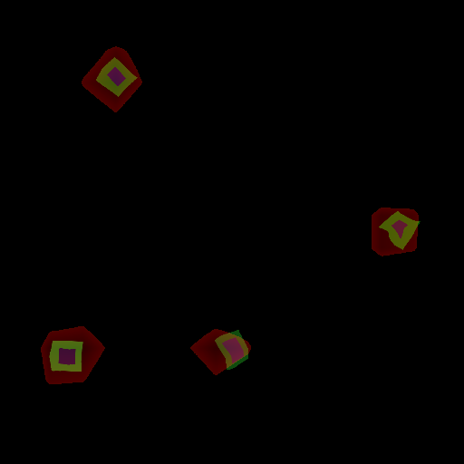
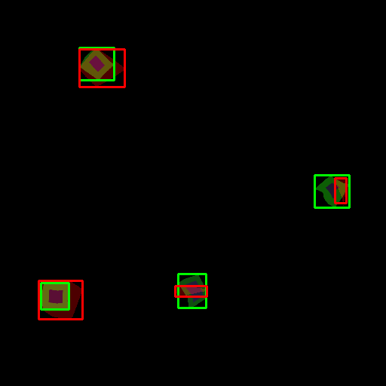
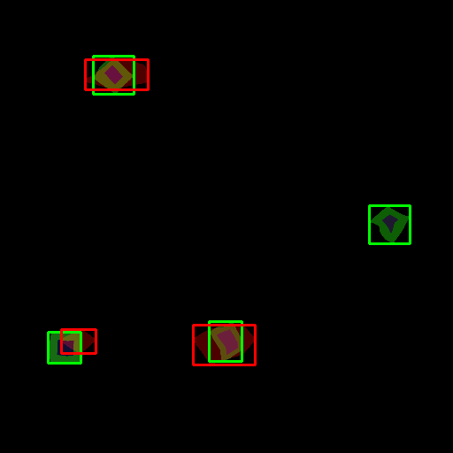
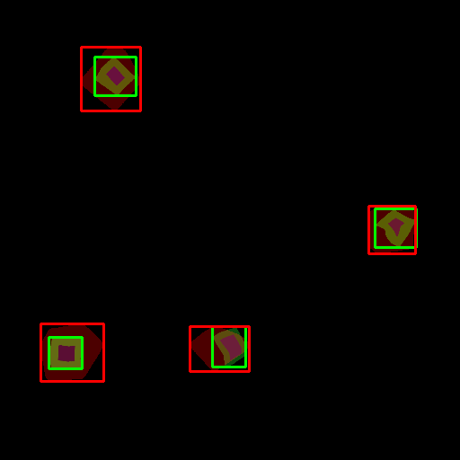
Qualitative analysis: SYNTHETIC – 4 instances
CAM (test130)
MinMaxCAM
ScoreCAM
Notes:
Smaller object instances are more challenging to localize. Easier to miss.
This example shows better-than-average performance
MinMaxCAM: more regularization may be needed
ScoreCAM: again better at capturing instances

Slide 33
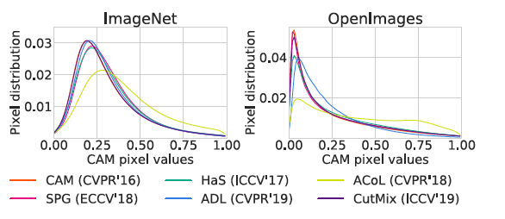
CAM pixel value distributions
Example from Choe et al., 2020b
CAM pixel value distributions (E.g. figure 13 in WSOL evaluation paper)

Slide 34
Cumulative distribution function (CDF)
To be investigated if useful
CDF of what?
Pixel values? (same as pixel distribution slide)

Slide 35
Next steps

Slide 36
Multiple-instance WSOL - Improvements
Challenge
1 operational threshold to extract bounding boxes
Not all object instances of similar intensity
Proposal: Iterative bounding box extraction
Process
Image is fed to model and CAM score map is computed
Bounding boxes are extracted using operational CAM threshold.
Bounding boxes are masked (deleted, greyed, noise-filled) in image
Operational CAM threshold is lowered. Repeat 1 if no stop criteria is met.
Possible stop criteria:
No new bounding boxes are found
Predefined minimum CAM threshold is reached
Predefined drop in classification score is reached
Predefined number of iterations is reached.

